Slide 1
Data Visualization
Presented by-
TEAM TECH ROCKERS
Achinthya M
Avinash
Chandan Kumar
Raksha D K
Shamanth N P
Thrisha

Slide 2
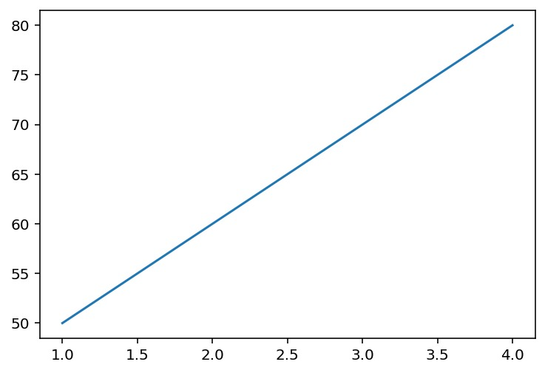
Introduction to Data Visualization & Matplotlib
Matplotlib is a Python library specifically used for creating plots and charts.
It supports various types of graphs like line plots, scatter plots, bar charts, histograms, and more.
Example :
import matplotlib.pyplot as plt
tests = [1, 2, 3, 4]
marks = [50, 60, 70, 80]
plt.plot(tests, marks)
plt.show()

Slide 3
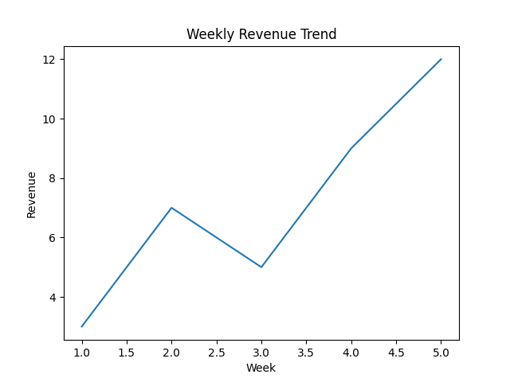
Line Plots
A line plot connects data points using straight lines.
It is mainly used to show trends across time or ordered values.
Humans easily recognize patterns and slopes visually.
Example:
plt.plot([1,2,3,4,5],[3,7,5,9,12])
plt.show()

Slide 4
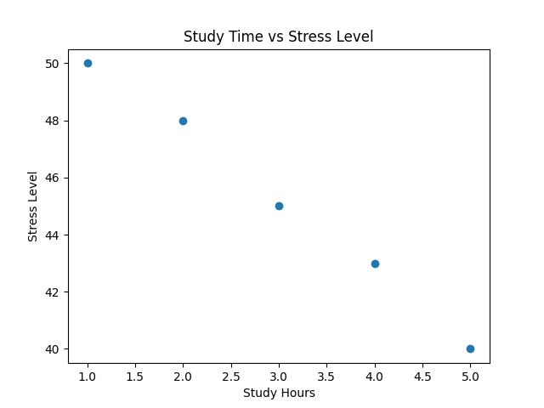
Scatter Plot for Relationship Analysis
A scatter plot displays individual data points without lines.
It helps identify correlations or patterns between two variables.
Commonly used in machine learning for feature comparison.
Example :
import matplotlib.pyplot as plt
x = [1, 2, 3, 4, 5]
y = [5, 4, 3, 2, 1]
plt.scatter(x, y)
plt.show()

Slide 5
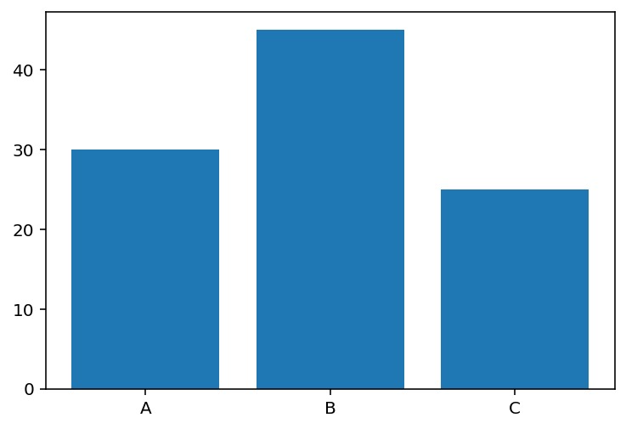
Bar Chart for Categorical Data
Bar charts are used to compare values across categories.
Each bar represents a category and its corresponding quantity.
Useful for comparisons like sales, students, or departments.
Example :
import matplotlib.pyplot as plt
classes = ['A', 'B', 'C']
students = [30, 45, 25]
plt.bar(classes, students)
plt.show()

Slide 6
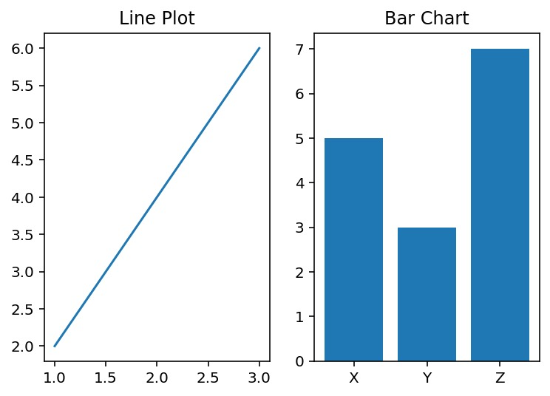
Customizing Plots & Subplots
Plots can be improved by adding titles, axis labels, legends, and gridlines for better clarity.
Subplots allow multiple charts to be displayed in a single figure for easy comparison.
Example:
import matplotlib.pyplot as plt
plt.subplot(1, 2, 1)
plt.plot([1,2,3], [2,4,6])
plt.title("Line Plot")
plt.subplot(1, 2, 2)
plt.bar(['X','Y','Z'], [5,3,7])
plt.title("Bar Chart")
plt.show()

Slide 7
Thank You

